Slide 1
Use Case 12
Lab 2: Skin Lesion Segmentation
Winter School 25/01/2022

Slide 2
Contents
3
Skin lesion image analysis
4
ISIC
Dataset
6
Models
9
Pre and Post Processing
13
Results
16
Resources
18

Slide 3
Skin Lesion Image Analysis
Introduction
Skin cancer is a major public health issue, with malignant melanoma being the deadliest form of it and presenting millions of newly diagnosed cases every year.
Dermoscopy is an imaging technique that eliminates the surface reflection of skin. By removing surface reflection, visualization of deeper levels of skin is enhanced.
When used by expert dermatologists, dermoscopy provides improved diagnostic accuracy, in comparison to standard photography.

Slide 4

ISIC
International Skin Imaging Collaboration
The International Skin Imaging Collaboration (ISIC) contains the largest publicly available collection of quality controlled dermoscopic images of skin lesions.
Collected from leading clinical centers internationally and acquired from a variety of devices within each center.
Since 2016, ISIC has sponsored annual challenges for the computer science community

Slide 5
ISIC 2017 Challenge
Purpose of the challenge: develop image analysis tools to enable the automated diagnosis of melanoma from dermoscopic images.
Part 1: Lesion Segmentation
Part 2: Detection and Localization of Visual Dermoscopic Features/Patterns
Part 3: Disease Classification
Segmentation is defined as the recognition of the set of pixels that constitute the skin lesion within the image. It is employed in 2017 and 2018 challenges.
The 2017 challenge was chosen because for the 2018 challenge test ground truth are still not provided.

Slide 6
Dataset

Slide 7
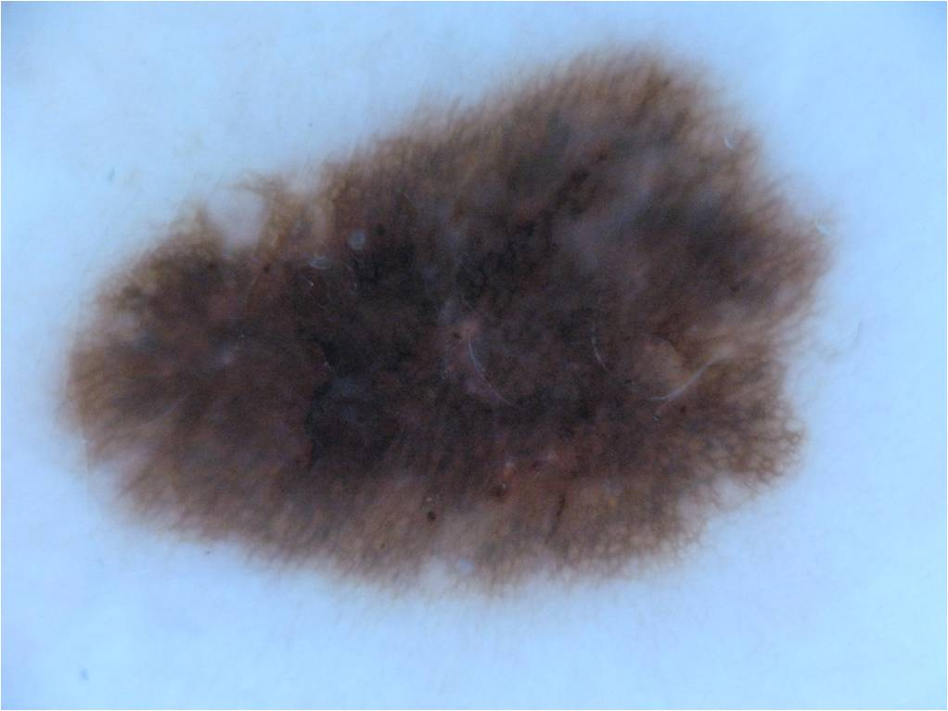
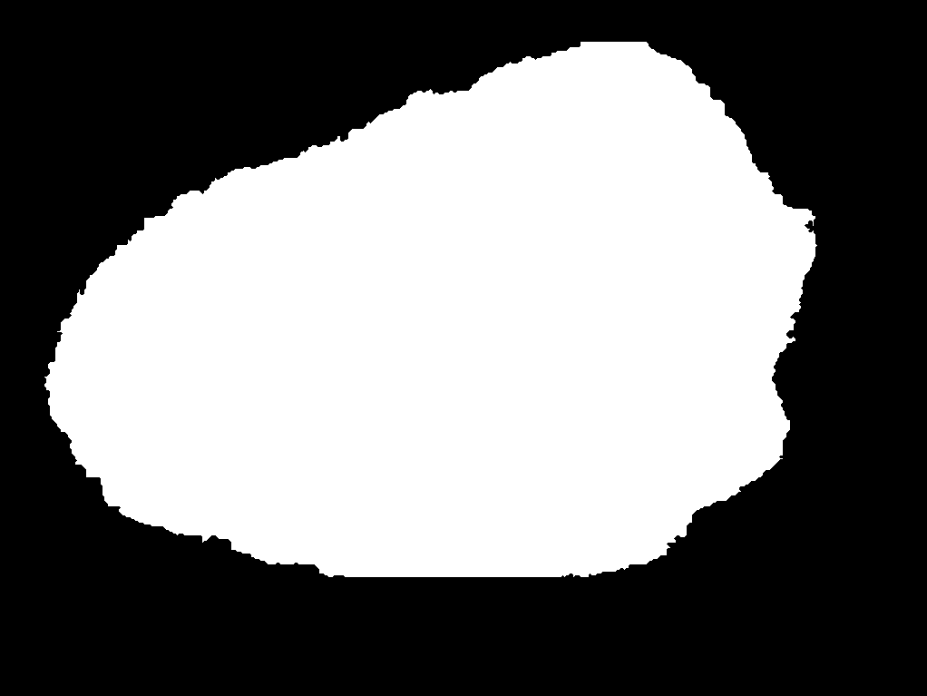
Segmentation Dataset
Goal: automated predictions of lesion segmentation boundaries from dermoscopic images, in the form of a binary mask (0 background, 255 foreground).

Slide 8
Segmentation Dataset
Data description
Images are in .jpg format, while masks in .png format.
Each image has only one lesion within it
Dimensions of the images: from 576x768 to 6748x4439
Split | Number of images
Training | 2000
Validation | 150
Test | 600

Slide 9
Models

Slide 10

UNet
Standard approach: encoder-decoder convolutional neural network.
Encoder: increase the “what” and reduce the “where”
Decoder: create high-resolution segmentation map
UNet, created specifically for biomedical image segmentation.
Upsampling convolutions concatenate with features from contracting path
Several modified UNet over the years, for example adding batch normalization and scaling the output segmentation map with the same resolution of the input.

Slide 11
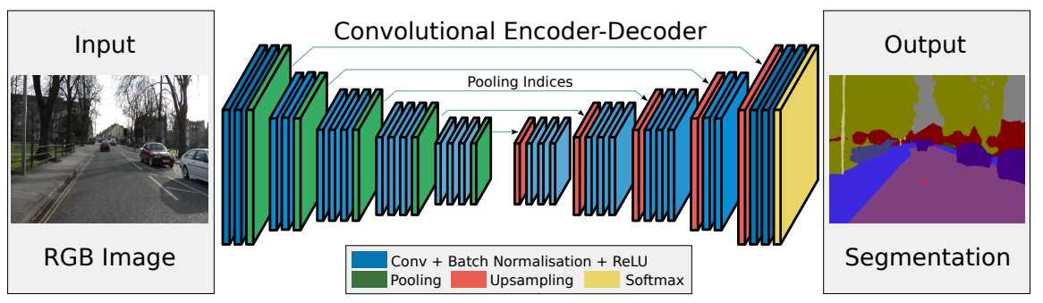
SegNet
Same approach: encoder-decoder convolutional neural network.
Encoder: VGG16, with pooling layers that memorize the locations of the maximum feature value in each pooling window for each encoder feature map.
Decoder: for each encoder layer, there exists a corresponding decoder layer to upsample the feature maps to its original size, which uses the memorized max-pooling indices from the corresponding encoder feature map. In this way, SegNet uses less memory compared to UNet, which concatenate the entire feature map from the encoder.
Actually, EDDL for now didn’t retrieve the pooling indices, so the upsample is just a resize of the image

Slide 12

Metric
Metric: Jaccard index (Intersection over Union)
Quantify the percent overlap between the target mask and our prediction output
Number of pixels common between the target and prediction masks divided by the total number of pixels present across both masks.
This metric is closely related to the Dice coefficient which is often used as a loss function during training.
$$IoU= \frac{|target∩prediction|}{|target∪prediction|}= \frac{|target∩prediction|}{\left|target\right|+\left|prediction\right|−|target∩prediction|}$$
$$Dice coefficient=\frac{2 |target∩prediction|}{\left|target\right| +\left|prediction\right|}$$

Slide 13
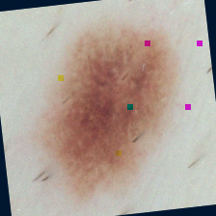
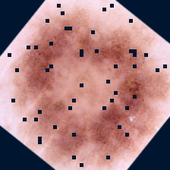
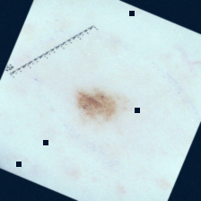
Pre Processing
Pre processing consists in several data augmentation functions:
training_augs = ecvl.SequentialAugmentationContainer([ ecvl.AugResizeDim(image_size, ecvl.InterpolationType.cubic, gt_interp=ecvl.InterpolationType.nearest), ecvl.AugMirror(.5), ecvl.AugFlip(.5), ecvl.AugRotate([-180, 180]), ecvl.AugAdditivePoissonNoise([0, 10]), ecvl.AugGammaContrast([0.5, 1.5]), ecvl.AugGaussianBlur([0, 0.8]), ecvl.AugCoarseDropout([0, 0.03], [0.02, 0.05], 0.25), ecvl.AugToFloat32(255, divisor_gt=255), ecvl.AugNormalize([0.6681, 0.5301, 0.5247], [0.1337, 0.1480, 0.1595]), # isic stats ])

Slide 14
Pre Processing
Or in ECVL Augmentation Language:
SequentialAugmentationContainer
AugResizeDim dims=(512,512) interp="cubic" gt_interp="nearest"
AugMirror p=0.5
AugFlip p=0.5
AugRotate angle=[-180, 180]
AugAdditivePoissonNoise lambda=[0, 10]
AugGammaContrast gamma=[0.5, 1.5]
AugGaussianBlur sigma=[0, 0.8]
AugCoarseDropout p=[0, 0.03] drop_size=[0.02, 0.05] per_channel=0.25
AugToFloat32 divisor=255 divisor_gt=255
AugNormalize mean=(0.6681, 0.5301, 0.5247) std=(0.1337, 0.1480, 0.1595)
end

Slide 15
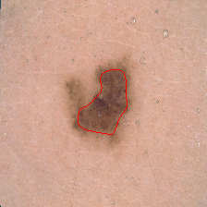
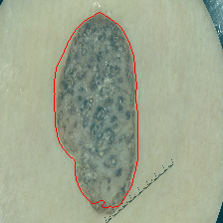
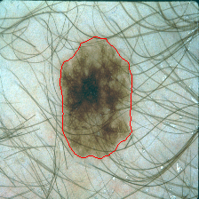
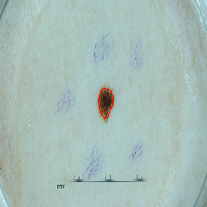
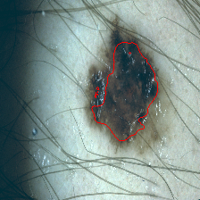
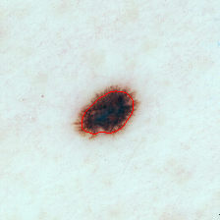
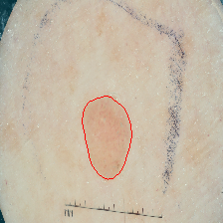
Post Processing
To qualitatively evaluate the results, when the output of the neural network is saved, a little of post processing is added.
ConnectedComponentsLabeling finds the connected components of the predicted mask
Their contours are then colored red on the original image
tmp, labels = ecvl.Image.empty(), ecvl.Image.empty() ecvl.ConvertTo(img_t, tmp, ecvl.DataType.uint8) ecvl.ConnectedComponentsLabeling(tmp, labels) ecvl.ConvertTo(labels, tmp, ecvl.DataType.uint8) contours = ecvl.FindContours(tmp) ecvl.ConvertTo(orig_img_t, tmp, ecvl.DataType.uint8) tmp_np = np.array(tmp, copy=False) for cseq in contours: for c in cseq: tmp_np[c[0], c[1], 0] = 255 tmp_np[c[0], c[1], 1] = 0 tmp_np[c[0], c[1], 2] = 0

Slide 16
Results
Model | Loss | Optimizer | Initial LR | Epochs | Best epoch | Validation IoU | Test IoU
SegNet | Binary Cross Entropy | Adam | 1e-5 | 100 | 49 | 0.725 | 0.708
SegNetBN | Binary Cross Entropy | Adam | 1e-5 | 100 | 99 | 0.745 | 0.714
Unet | Binary Cross Entropy | Adam | 1e-5 | 100 | 46 | 0.755 | 0.718
Unet | Dice | Adam | 1e-3 | 100 | 74 | 0.750 | 0.733

Slide 17
Resources

Slide 18
Resources
Original Dataset
ISIC Challenge Datasets
Prepared Dataset
isic_segmentation.zip (11,3 GB) Option 1 Option 2
Pipeline Repository
UC12_pipeline
use-case-pipelines

Slide 19
Thank you!
Costantino Grana
costantino.grana@unimore.it

